Slide 1
PREDICTING ELIGIBILITY FOR SOCIAL WELFARE SCHEMES USING MACHINE LEARNING
AI/ML PROJECT
Presented By:
1. Shiv Sonker-Haridwar University-CSE

Slide 2
OUTLINE
Problem Statement (Should not include solution)
Proposed System/Solution
System Development Approach (Technology Used)
Algorithm & Deployment
Result (Output Image)
Conclusion
Future Scope
References

Slide 3
PROBLEM STATEMENT
Example: The National Social Assistance Program (NSAP) is a flagship social security and welfare program by the Government of India. It aims to provide financial assistance to the elderly, widows, and persons with disabilities belonging to below-poverty-line (BPL) households. The program consists of several sub-schemes, each with specific eligibility criteria. Manually verifying applications and assigning the correct scheme can be a time-consuming and error-prone process. Delays or incorrect allocation can prevent deserving individuals from receiving timely financial aid. Your task is to design, build, and evaluate a multi-class classification model that can accurately predict the most appropriate NSAP scheme for an applicant based on their demographic and socio-economic data. The goal is to create a reliable tool that could assist government agencies in quickly and accurately categorizing applicants, ensuring that benefits are delivered to the right people efficiently. .

Slide 4
PROPOSED SOLUTION
The proposed system aims to automate and improve the process of assigning applicants to the most appropriate social welfare scheme under the National Social Assistance Program (NSAP). By leveraging machine learning techniques and cloud-based AI services, the system will analyze demographic and socio-economic data to accurately predict scheme eligibility. This will reduce manual effort, minimize errors, and ensure timely benefit distribution. The solution will be implemented using IBM Cloud with watsonx.ai Studio and consists of the following components:
📊 Data Collection:
Gather historical applicant data including age, gender, income level, disability status, marital status, and poverty classification.
Include scheme-wise labeled data representing eligibility outcomes under NSAP sub-programs.
Store and manage datasets securely using IBM Cloud storage services.
🧹 Data Preprocessing:
Clean the dataset to handle missing values, duplicate records, and inconsistent entries.
Encode categorical variables such as gender, employment status, and scheme categories.
Normalize numerical features to improve model performance.
Perform feature selection and engineering to identify the most influential eligibility factors.
🤖 Machine Learning Model Development:
Use watsonx.ai Studio to build and train multi-class classification models such as Decision Trees, Random Forest, Gradient Boosting, or Logistic Regression.
Train models using labeled applicant data to predict the most suitable NSAP scheme.
Optimize model parameters to improve prediction accuracy and reliability.
☁️ Cloud Deployment:
Deploy the trained model on IBM Cloud for real-time prediction services.
Create a web-based or API-driven interface where applicant details can be entered.
Integrate the model to instantly return the predicted welfare scheme eligibility.
📈 Evaluation:
Evaluate model performance using metrics such as Accuracy, Precision, Recall, F1-score, and Confusion Matrix.
Compare multiple models within watsonx.ai Studio to select the best-performing classifier.
Continuously monitor and retrain the model with updated applicant data for improved results.

Slide 5
TECHNOLOGY USED
☁️ Cloud Platform:
IBM Cloud
Used for hosting datasets, machine learning models, and application services
Provides scalable infrastructure and secure data storage
🤖 AI/ML Development Environment:
IBM watsonx.ai Studio
Used for data preprocessing, model training, evaluation, and deployment
Supports automated machine learning and custom model building
Enables experiment tracking and performance comparison
📊 Programming & Data Handling:
Python
Used for data cleaning, feature engineering, and model development
Libraries such as Pandas, NumPy, Scikit-learn for data processing and ML algorithms
📦 Data Storage:
IBM Cloud Object Storage
Stores large NSAP datasets securely
Enables easy access for training and analysis

Slide 6
SYSTEM APPROACH
The system uses a cloud-based machine learning approach to predict eligibility for NSAP welfare schemes using demographic and beneficiary data. The solution is developed and deployed on IBM Cloud using watsonx.ai Studio for scalable and efficient model training and prediction.
🖥 System Requirements:
Laptop/PC with internet access
IBM Cloud account
Web browser
Python environment

Slide 7
ALGORITHM & DEPLOYMENT
Algorithm Selection:
Regression-based machine learning models were used to predict eligibility for NSAP welfare schemes. Regression was chosen for its ability to identify relationships between demographic features and scheme allocation, making it suitable for structured beneficiary data.
Data Input:
The model uses financial year, state and district codes, total beneficiaries, gender distribution, social category counts, Aadhaar linkage, and mobile registration as input features. The scheme code is the target output.
Training Process:
The model was trained using historical data after preprocessing, normalization, and encoding. Model performance was improved through validation and parameter tuning in IBM watsonx.ai Studio.
Prediction Process:
The trained model processes new demographic data to predict the appropriate welfare scheme in real time through cloud deployment.

Slide 8
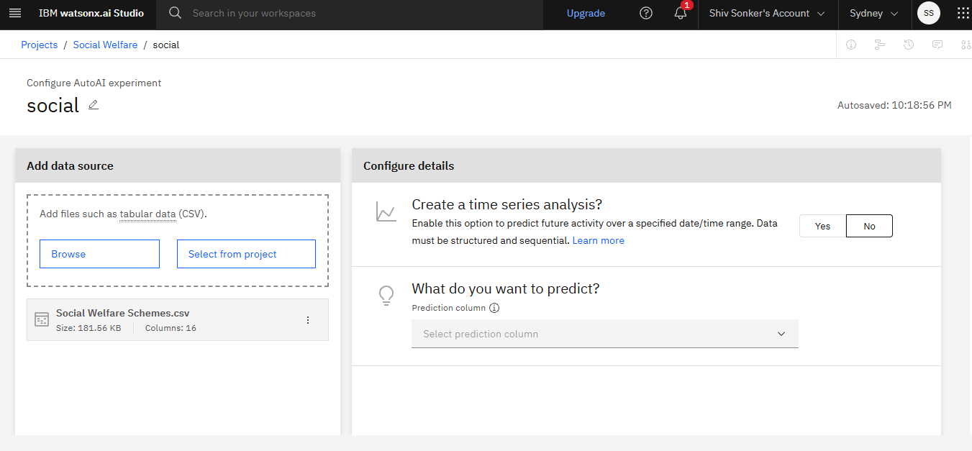
RESULT
.

Slide 9
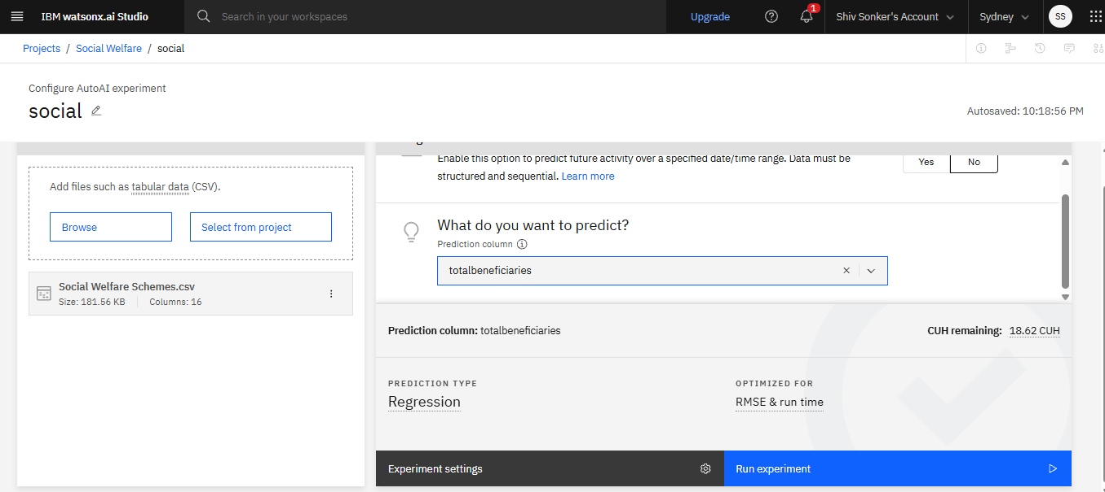
RESULT

Slide 10
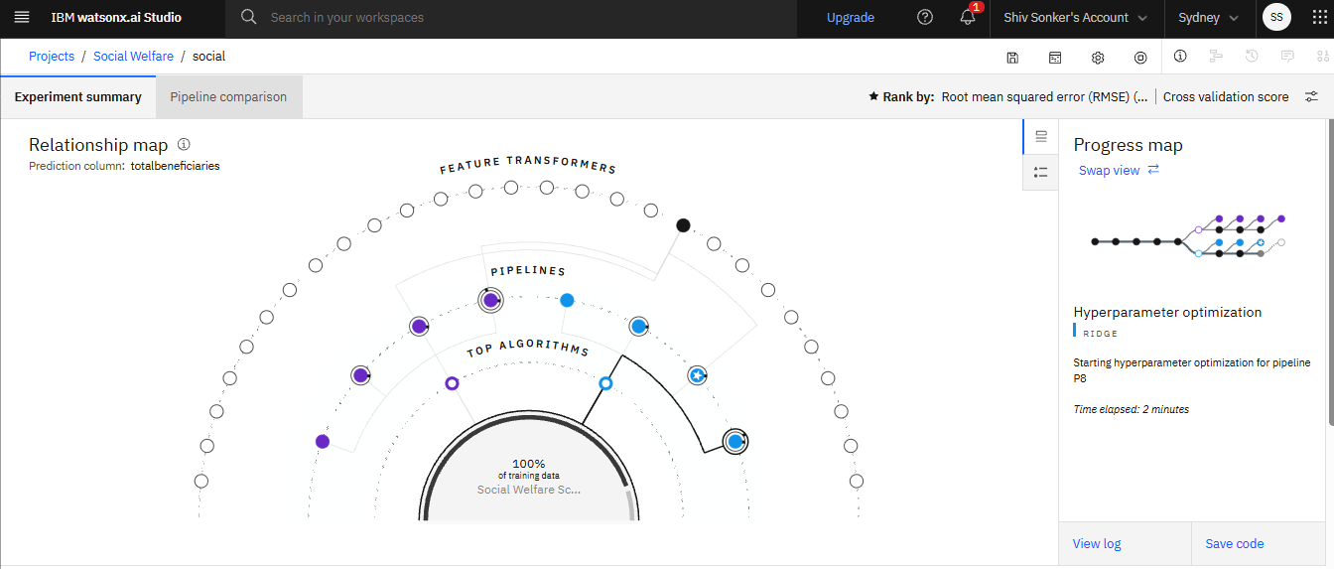
RESULT

Slide 11
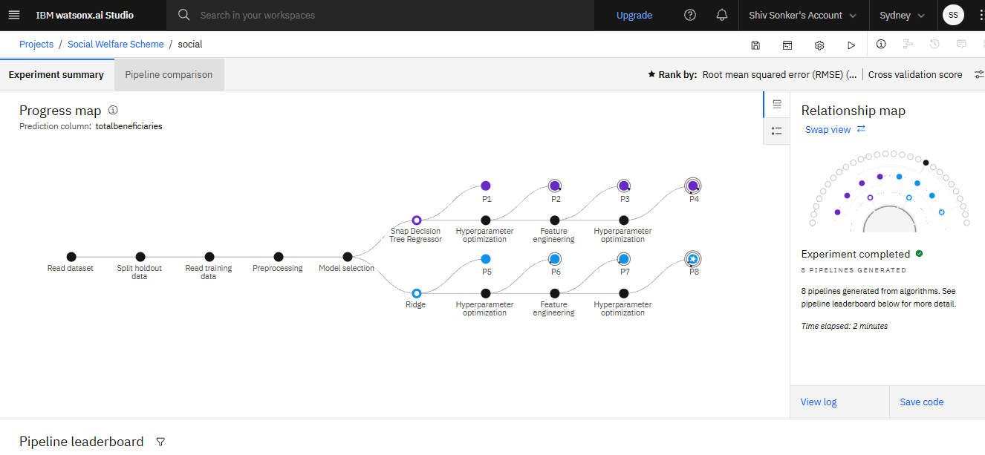
RESULT

Slide 12
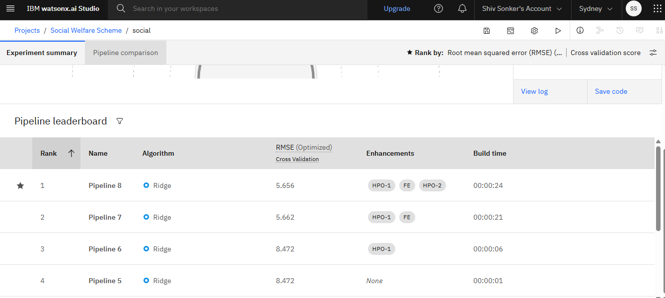
RESULT

Slide 13
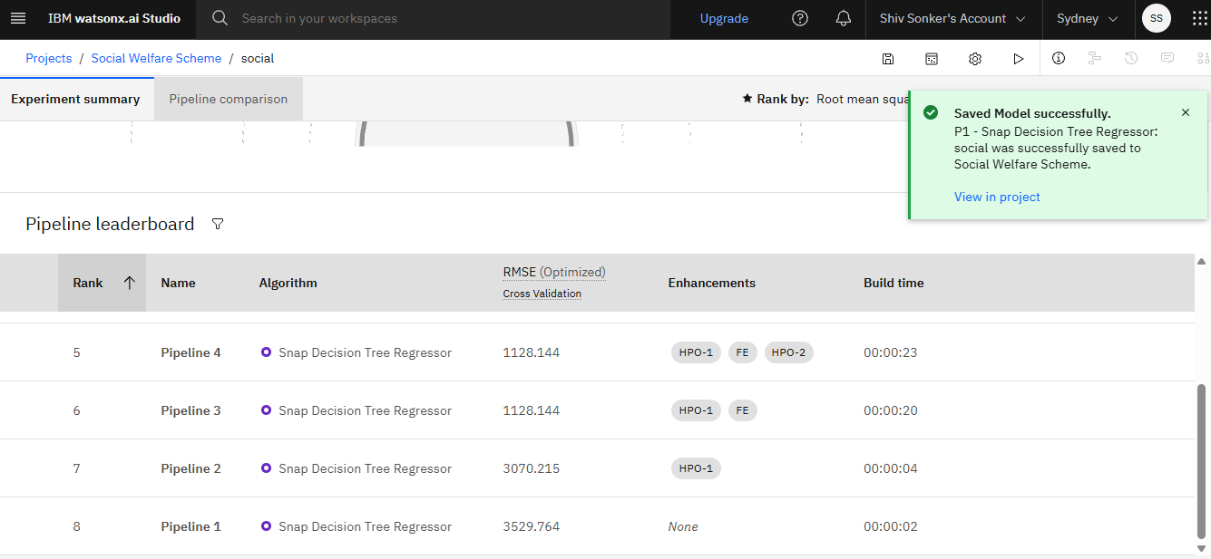
RESULT

Slide 14
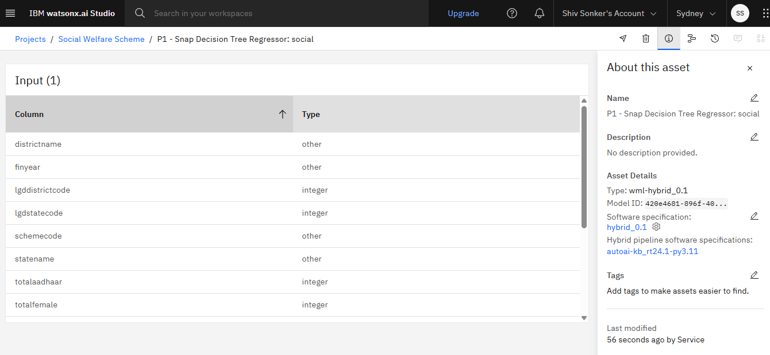
RESULT

Slide 15
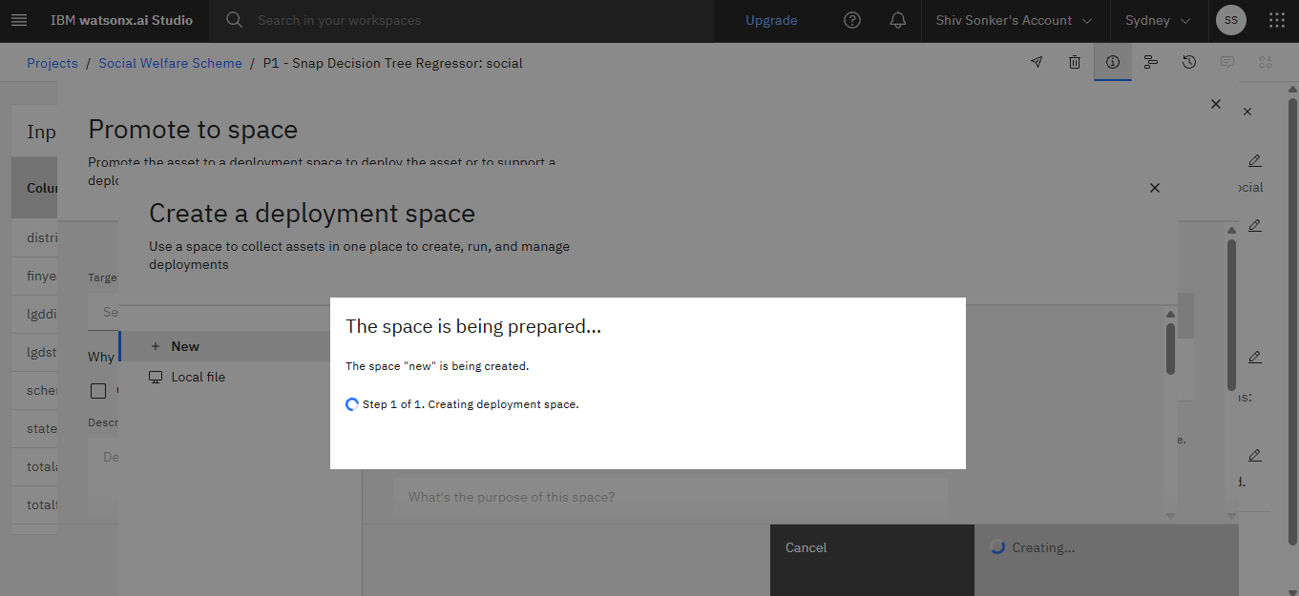
RESULT

Slide 16
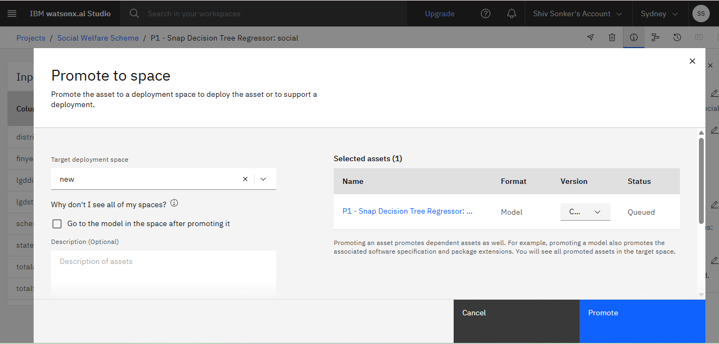
RESULT

Slide 17
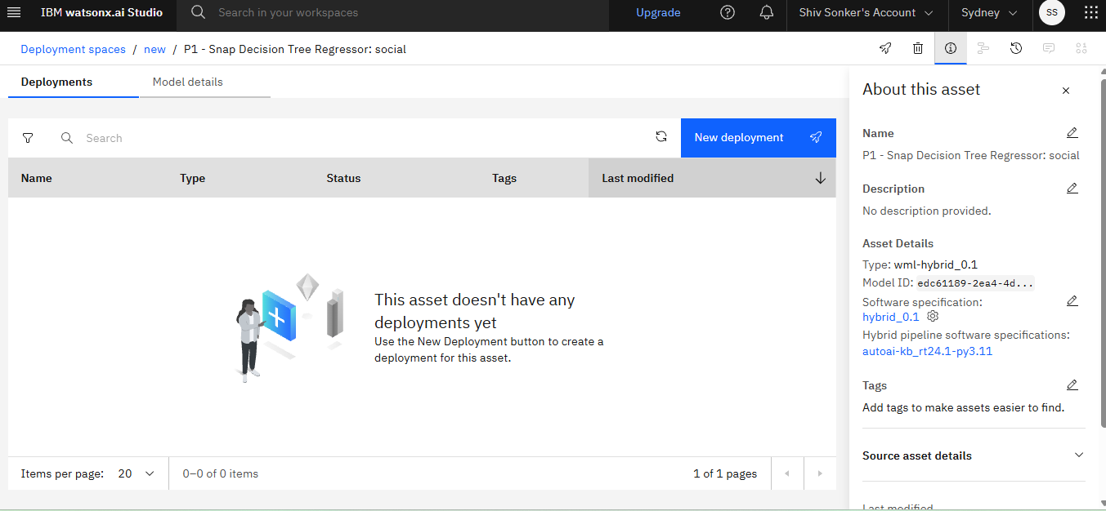
RESULT

Slide 18
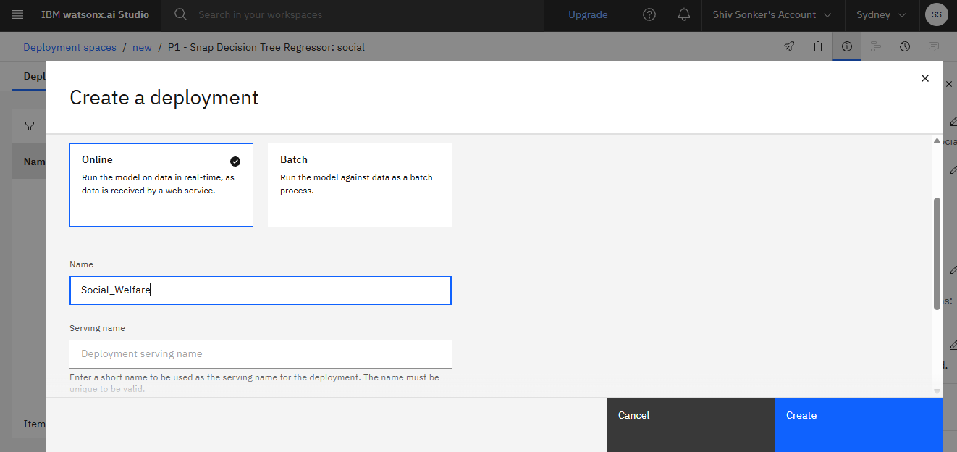
RESULT

Slide 19
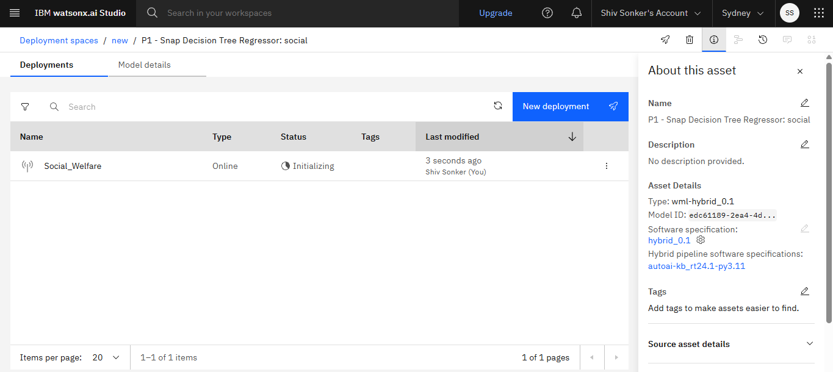
RESULT

Slide 20
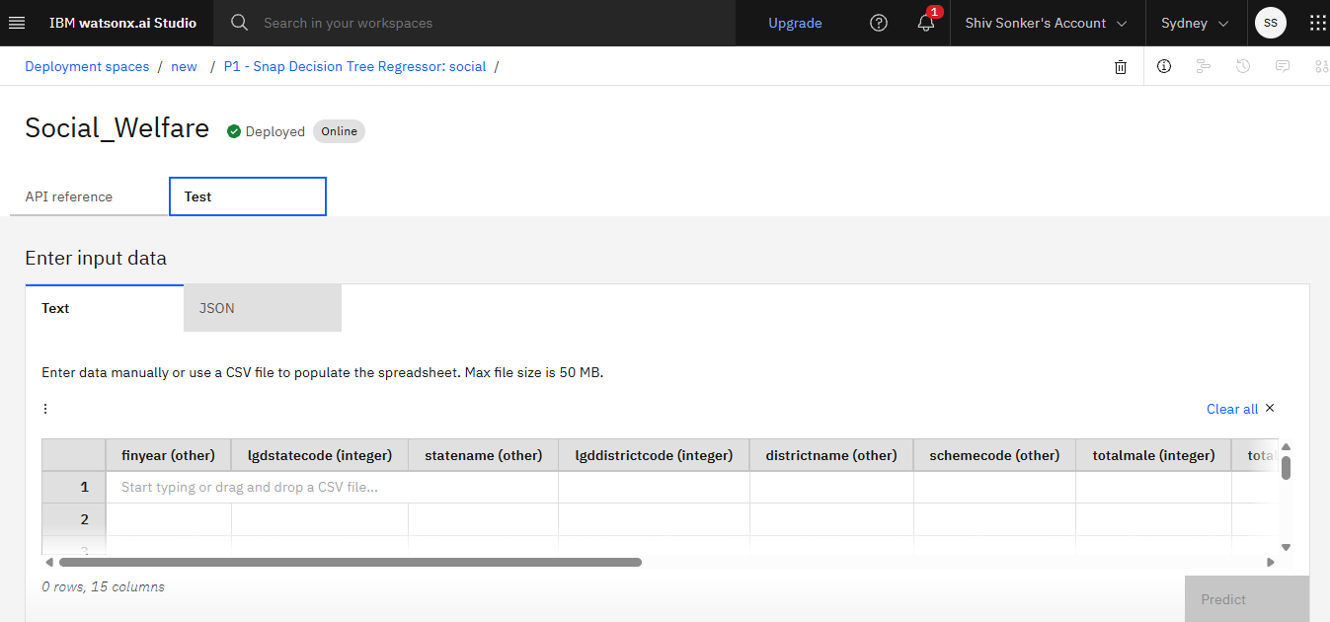
RESULT

Slide 21
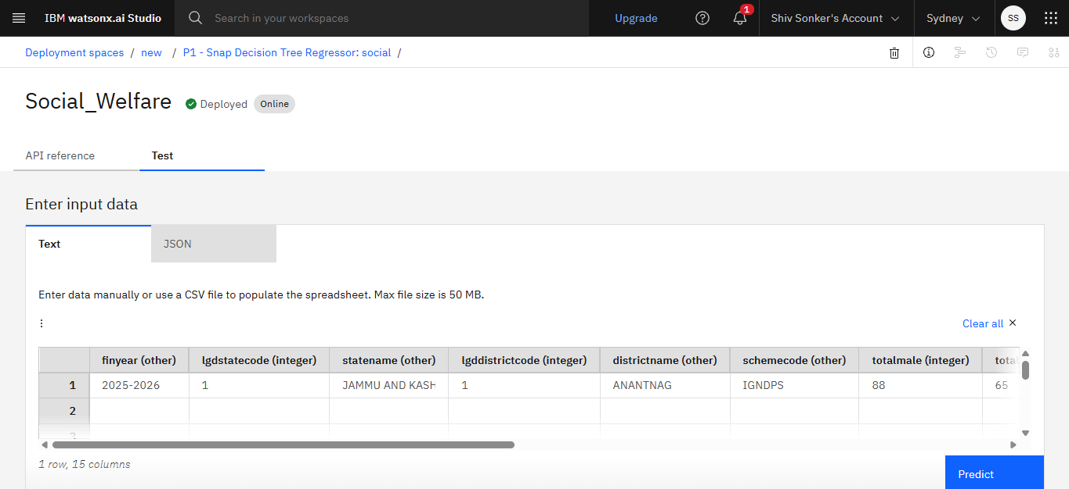
RESULT

Slide 22
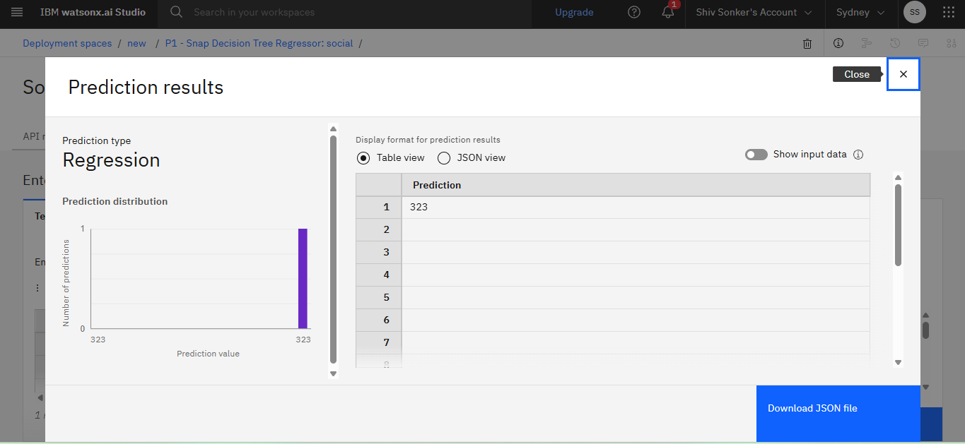
RESULT

Slide 23
CONCLUSION
This project successfully developed a machine learning-based system to predict eligibility for social welfare schemes under the National Social Assistance Program (NSAP) using demographic and beneficiary data. By leveraging IBM Cloud and watsonx.ai Studio, the solution provides a scalable and efficient platform for data processing, model training, and real-time prediction. The regression-based approach demonstrated the ability to identify meaningful patterns within large government datasets, reducing manual verification efforts and improving accuracy in scheme allocation. Overall, the system enhances transparency, speeds up decision-making, and supports government agencies in delivering welfare benefits to deserving individuals more effectively.

Slide 24
FUTURE SCOPE
The proposed system can be further enhanced by integrating real-time applicant data and additional socio-economic indicators such as employment status, health conditions, and education level to improve prediction accuracy. Advanced machine learning techniques like deep learning and ensemble models can be implemented to handle larger and more complex datasets. The system can also be extended with a user-friendly web or mobile application for easy access by government officials and citizens. Furthermore, integration with national databases such as Aadhaar and other digital governance platforms can enable automatic verification and faster scheme allocation, making the welfare distribution process more transparent, scalable, and efficient.

Slide 25
REFERENCES
Government of India, National Social Assistance Program (NSAP) – Official scheme guidelines and beneficiary framework.
IBM Corporation, IBM Cloud Documentation – Cloud infrastructure and AI deployment services.

Slide 26
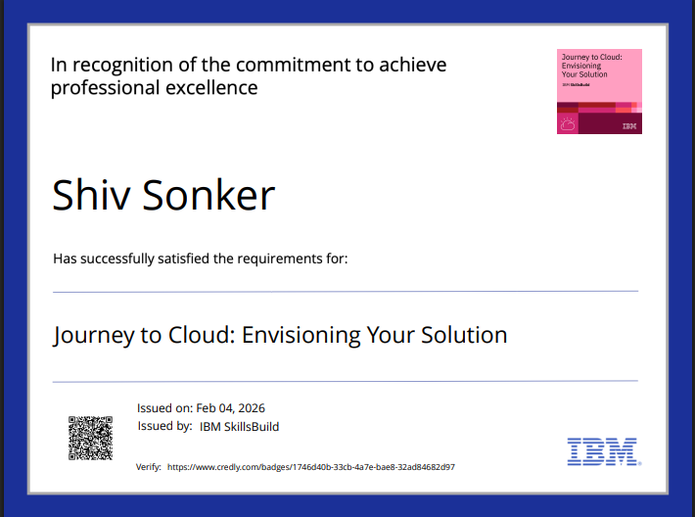
IBM CERTIFICATES

Slide 27
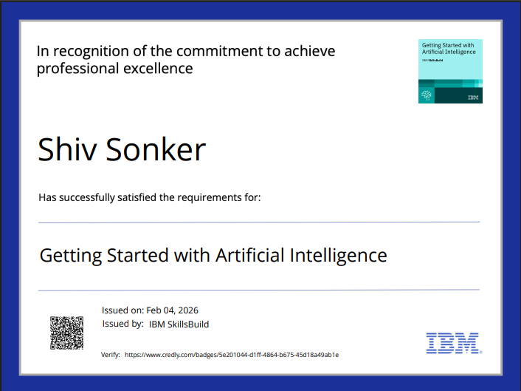
IBM CERTIFICATES

Slide 28
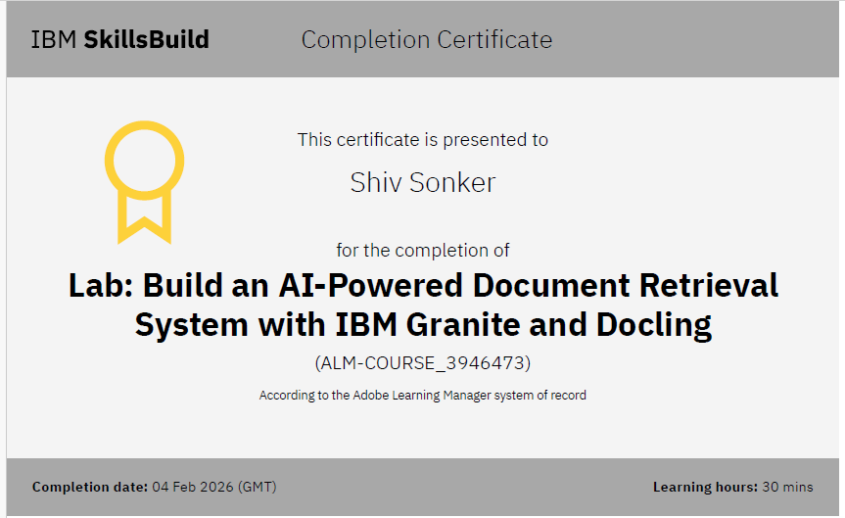
IBM CERTIFICATES

Slide 29
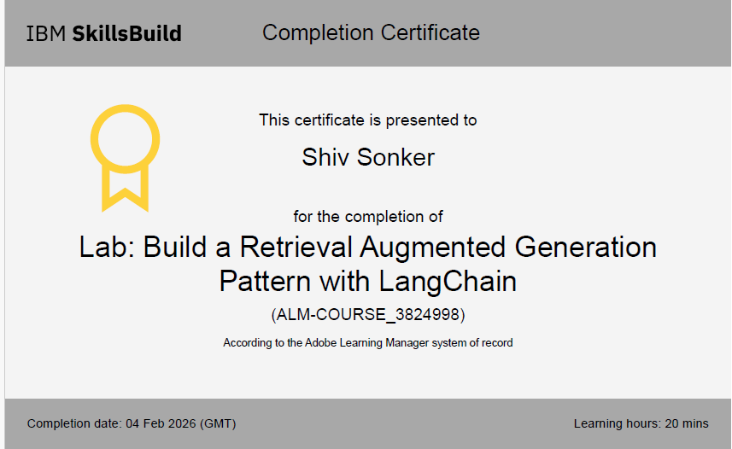
IBM CERTIFICATES

Slide 30
GITHUB LINK
https://github.com/ShivSonker08/IBM-Social-Welfare-Project.git

Slide 31
THANK YOU

